Slide 1


Slide 2
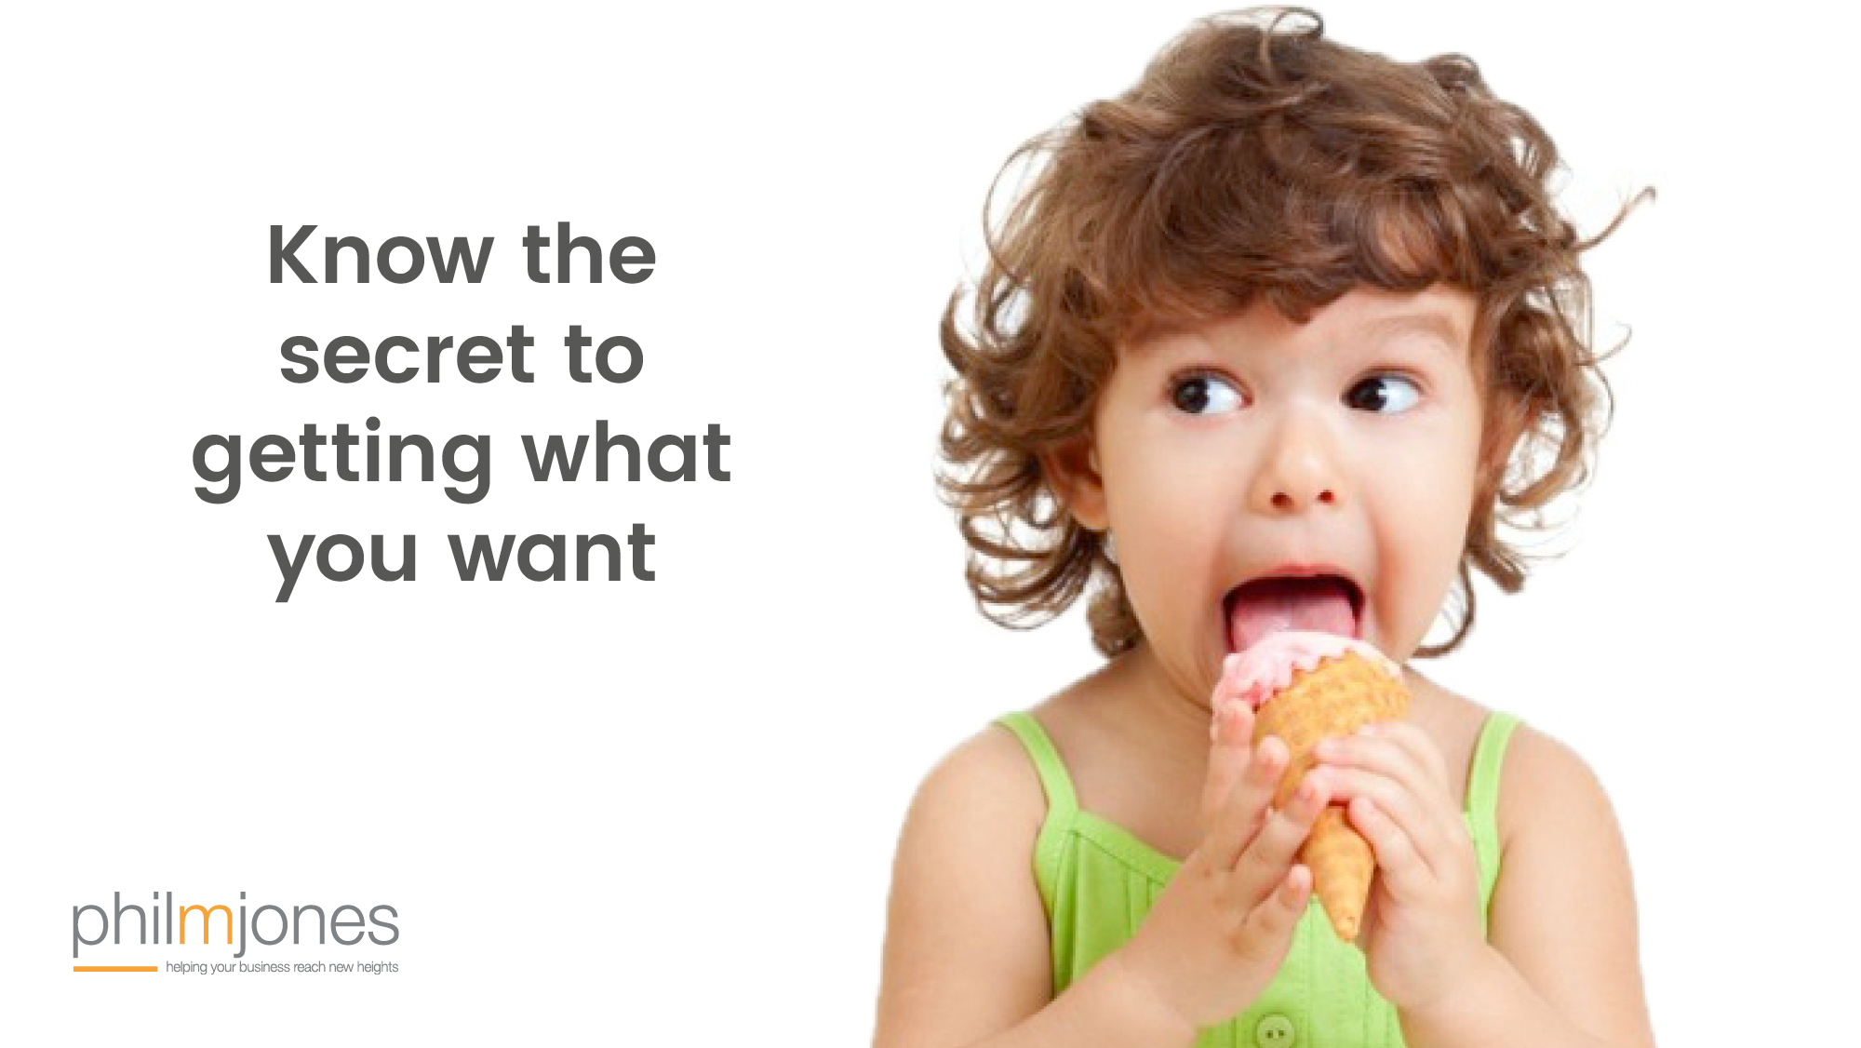

Slide 3


Slide 4

I’m not sure if its for you, but

Slide 5
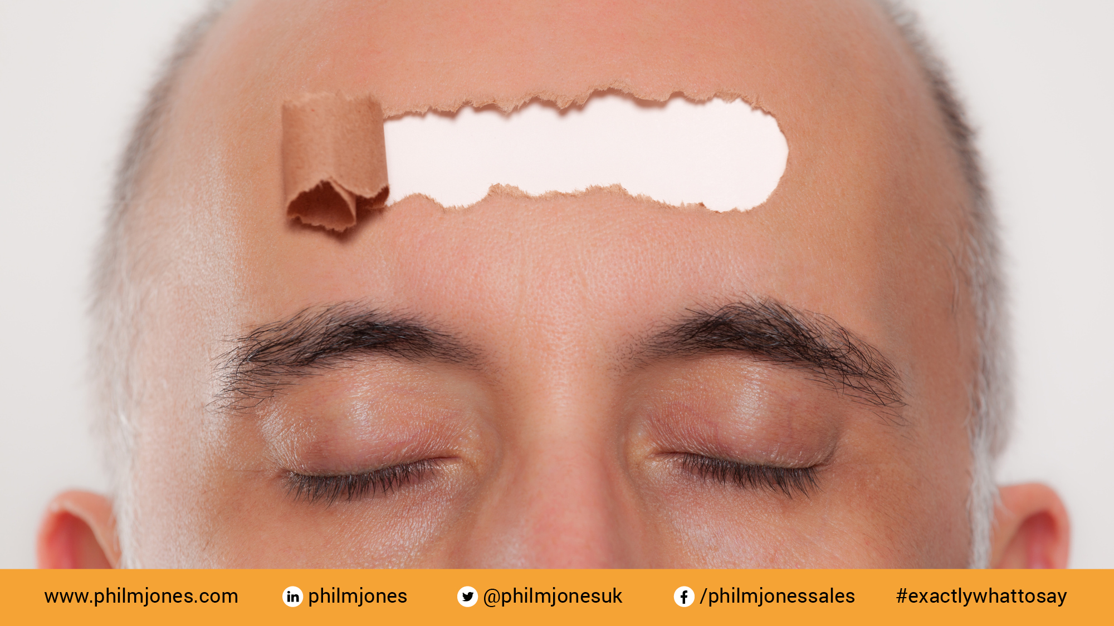
Open-minded

Slide 6


Slide 7


Slide 8
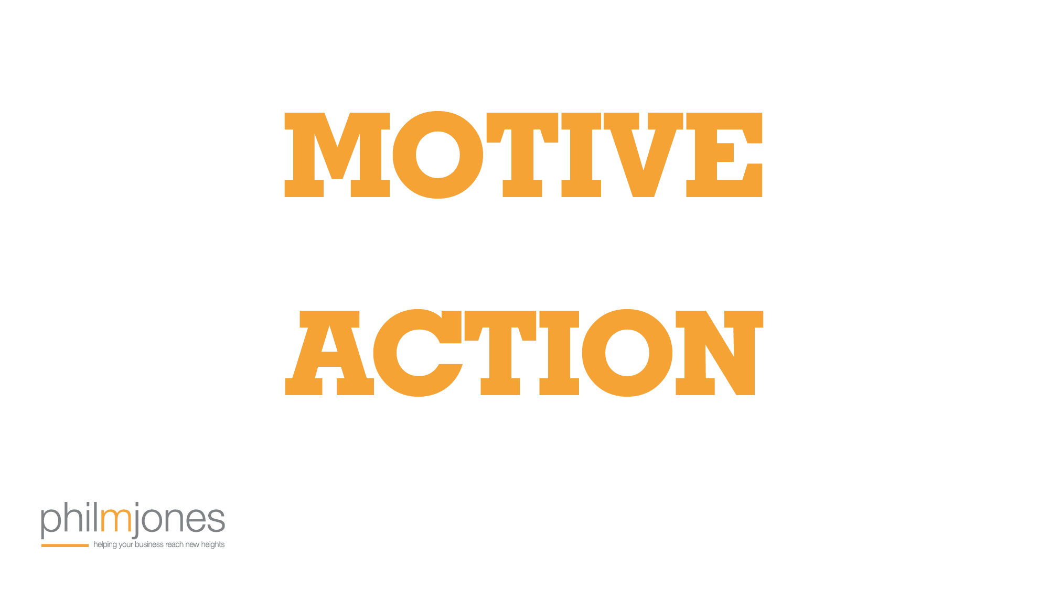

Slide 9


Slide 11

Just imagine

Slide 12

How would you feel if?

Slide 13


Slide 14
L
I
S
T
E
N

Slide 15
S
I
L
E
N
T

Slide 18
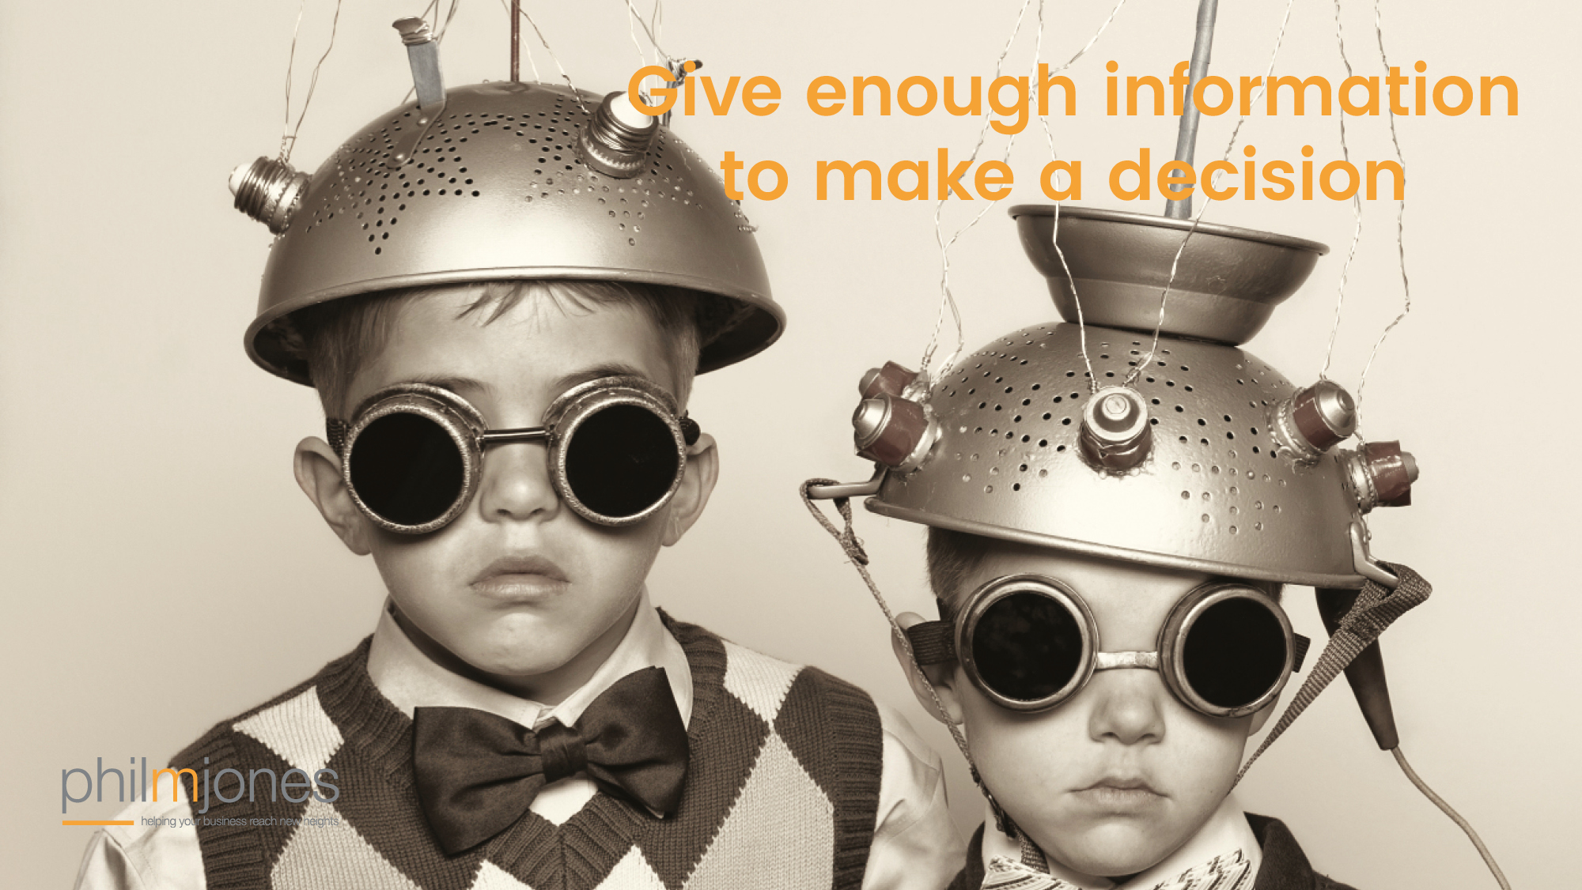

Slide 19

What do you know?

Slide 20
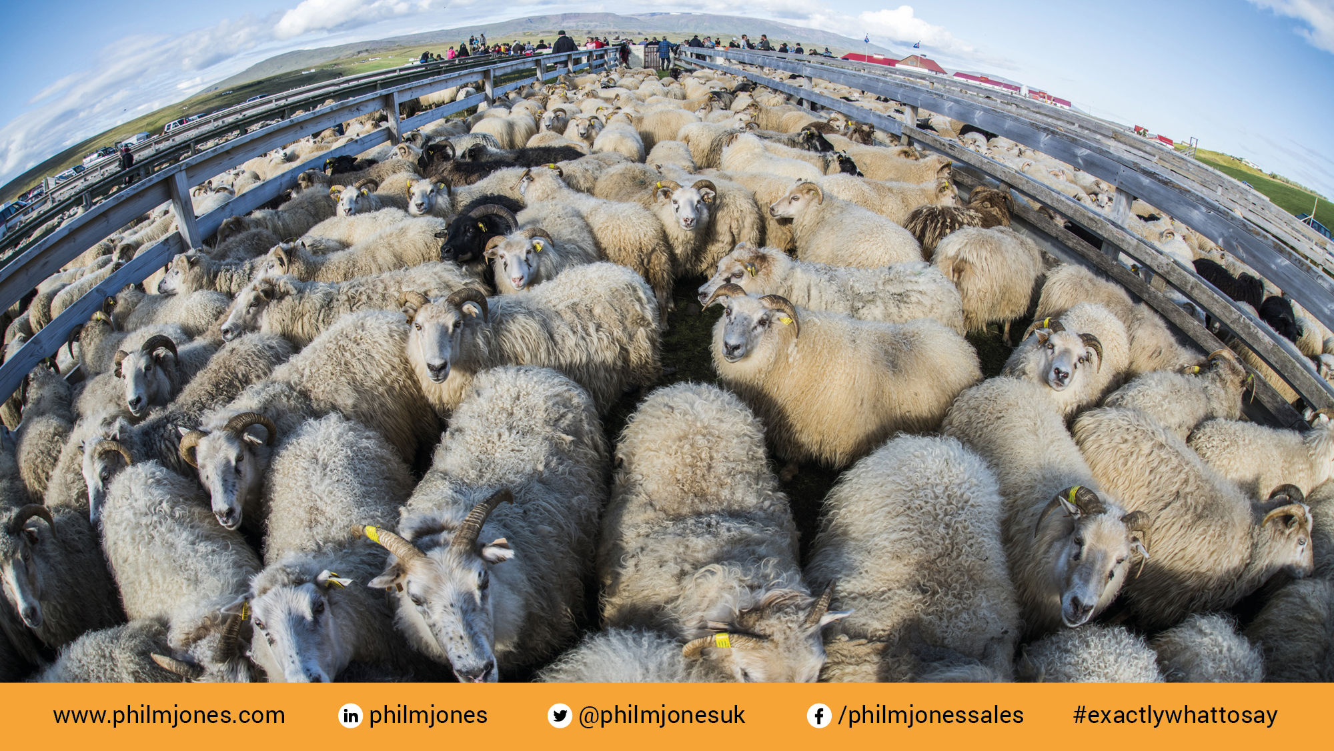
Most people

Slide 21
